Slide 1
Part II - PISA Dataset Exploration
by Alham Hotaki

Slide 2
Before you start:
You must have the README.md file ready that include a summary of main findings that reflects on the steps taken during the data exploration (Part I notebook). The README.md file should also describes the key insights that will be conveyed by the explanatory slide deck (Part II outcome)

Slide 3
Investigation Overview
Perform data exploratory and explanatory on PISA dataset utilizing data wrangling and visualization based on uni, bi, and multivariate visualizations.
The main feature of this dataset is the score obtained by the students in each discipline and the potential for understanding how a number of different factors can impact these scores and therefore the level of preparation for students around the world.

Slide 4
Features of Interest in Dataset
For the simplification purpose, it was supposed that the impact of the some of the factors shall be assessed on the performance of students in three (math, science and reading) areas in different countries:
1. Gender (ST04Q01)
2. Family Structure (FAMSTRUC)
3. Immigration status (IMMIG)
4. Education level of Father (FISCED)
5. Education level of Mother (MISCED)
6. Household Possessions (HOMEPOS, WEALTH, CULTPOS, HEDRES)
7. Use of ICT at home (ICTHOME)
8. Use of ICT for entertainment (ENTUSE)

Slide 5
Dataset Overview
PISA (Programme for International Student Assessment) is a study conducted by the Organisation for Economic Co-operation and Development (OECD) that aims to evaluate education systems worldwide by assessing the skills and knowledge of 15-year-old students. PISA data can provide insight into various aspects of student performance, including their performance in mathematics, reading, and science, as well as their socio-economic background, and parents level of education.
The file provided for this study, pisa2012.csv, contains data from a total of 485'490 students grouped in 636 columns.

Slide 6
(Visualization 1)
Write a comment about your visualization here. The visualization should be in the next cell, as a sub-slide type. Make sure your visualizations are polished!
Rubric Tip: Provide at least 3 polished visualizations to convey key insights. The total number of visualizations in the slideshow should be less than 50% of the number of visualizations in the exploratory analysis. For example, if the exploratory analysis (Part I) has 18 visualizations, the slideshow can have (3 - 8) visualizations.
Rubric Tip: Each visualization in the slideshow is associated with descriptive comments that accurately depict their purpose and your observation.
Rubric Tip: All plots in the slideshow are appropriate, meaning the plot type, encodings, and transformations are suitable to the underlying data.
Rubric Tip: All plots in the slideshow are polished, meaning all plots have a title, labeled x/y axes (with units), x/y ticks, and legends.

Slide 7
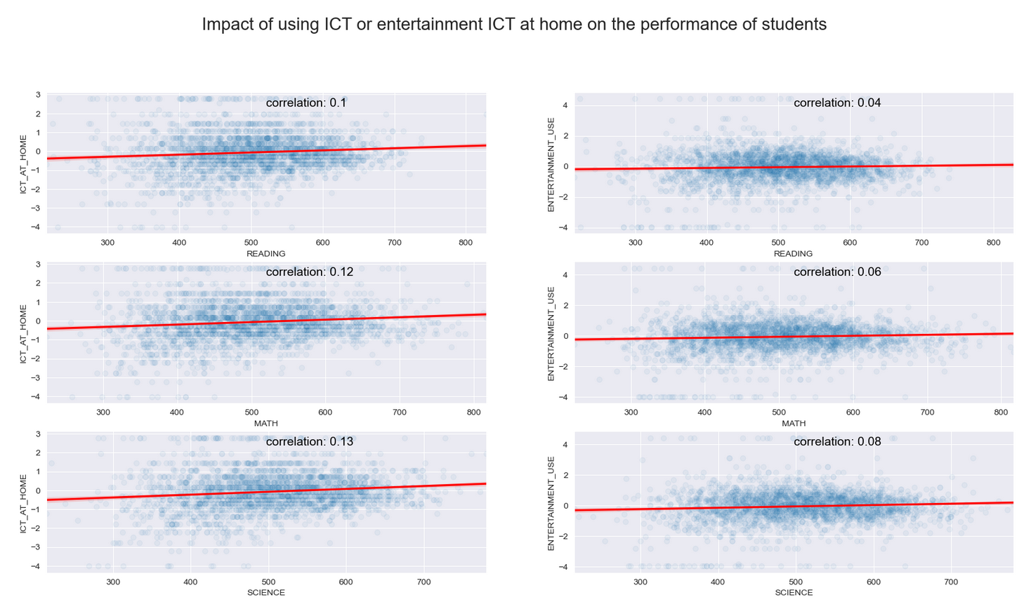
(Visualization 1)
Spending more time watching TV or using video games at home may negatively impact students' performance in school, but our data suggests that any correlation between the two is minimal. However, it is still important to consider the impact of these activities on students' physical and mental health.

Slide 8
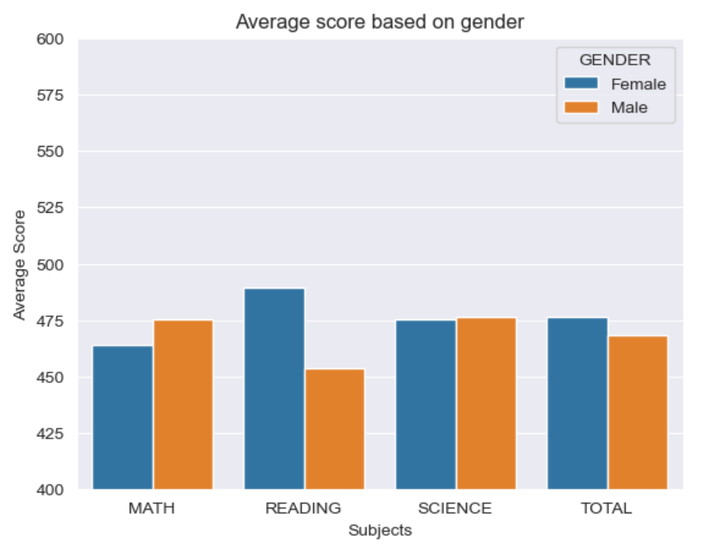
(Visualization 2)
It seems that while men and women are equally capable of understanding science, they may have different aptitudes for mathematics and reading.

Slide 9
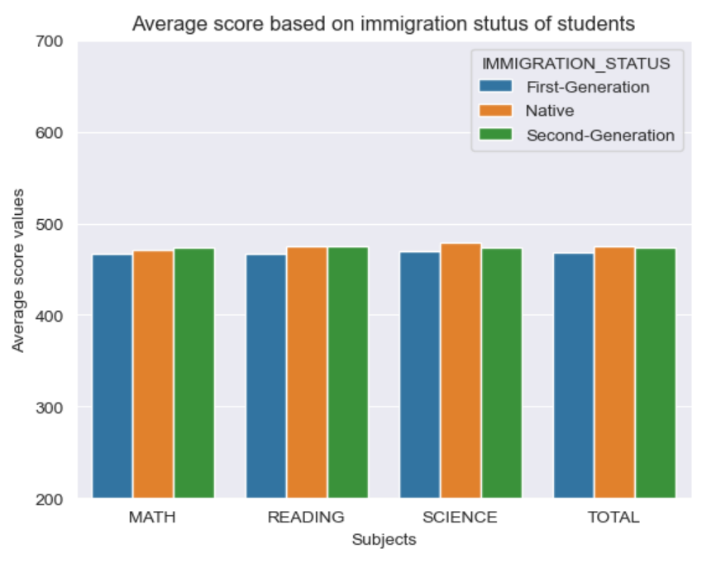
(Visualization 3)
Second-generation immigrant students outperform native students in mathematics and almost equaling them in reading.

Slide 10
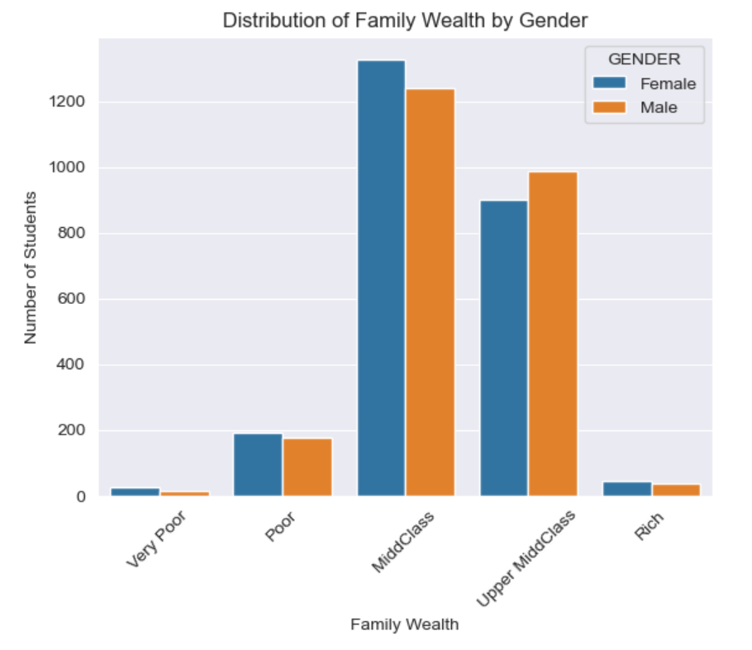
(Visualization 4)
Boys tend to benefit more from their family's wealth than girls.

Slide 11
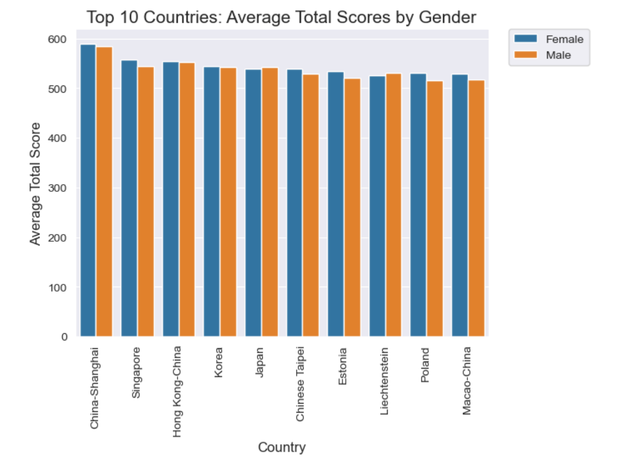
(Visualization 5)
No major European economies are among the top-performing countries in PISA compared to East Asian nations. Interestingly, female students are dominating the list.

Slide 12
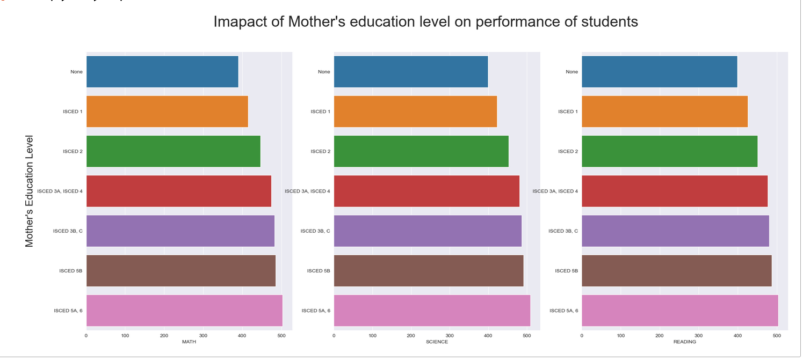
(Visualization 6)
Mothers and fathers who have completed higher education levels have the greatest impact on the success of students in mathematics, reading, and science.

